Slide 1
MTMM
Brown Chapter 6
Also recommend:
http://davidakenny.net/cm/mtmm.htm

Slide 2
MTMM
Multi-trait multi-method
Traits – the latent factors you are trying to measure
Methods – the way you are measuring the latent factors

Slide 3
MTMM
Why?
Convergent validity – how much different assessments measure the same traits
So you want scale 1 and scale 2 to measure trait 1 equally well

Slide 4
MTMM
Why?
Discriminant validity – how much different assessment methods diverge in measurement of different traits
So you want scale 1 and scale 2 to measure trait 1 and trait 2 differently
That means that both scales are equally useful

Slide 5
MTMM
Why?
Method effects – how much scales cause overlap in traits
So you want scale 1 to measure trait 1 and trait 2 differently

Slide 6
Reminder Model Comparison
You are using a set of nested CFAs, so you want to use a chi-square difference test.
(I think you could also probably easily use AIC or ECVI as well, but chi-square is the most common).
You can also use a new rule that we will use extensively for MG models:
Change in CFI > .01 is a significant change in fit.

Slide 7
Steps
There are lots of approaches to MTMM
We are going to cover the Widaman rules
You can also use correlation tables only, different methods of error correlation, etc.

Slide 8
Steps
First, check out the new model specification, as it is not a normal CFA.
You do not want to use normal scaling on the manifest variables.
You should instead set the variance of each latent to 1.
Use std.lv = TRUE.

Slide 9
Steps
Model 1 – Correlated Traits / Correlated Methods
You will correlate traits with each other.
You will correlate methods with each other.
You will NOT cross correlate methods and traits.
So how can we force lavaan to do that?
Latent ~~ 0*latent

Slide 10
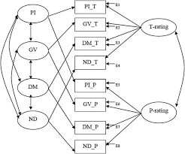
Traits
Methods

Slide 11
Steps
Model 1
One of the big concerns/complaints with the traditional MTMM steps is that Model 1 is likely to create a heywood case with a negative error variance.
Mostly because models are so complex – but think a lot of this stuff is correlated (on purpose), so it’s hard to figure out where all that correlation goes.

Slide 12
Steps
Model 1
If you get a Heywood case of negative variance:
Set the value to something small and positive
If you know the variance by having the real data, set it to that.
Set the value equal to another small positive parameter.

Slide 13
Comparisons
Every model (2-4) is compared to model 1.
Model 1 represents the best case scenario, wherein traits are correlated but not perfectly and they are estimated by the measurements but not perfectly.

Slide 14
Steps
Model 2 – No traits / correlated methods
Completely delete the trait latents (leave those indicators alone!).
So now, you are basically testing methods.

Slide 15
Traits
Methods

Slide 16
Comparisons
Model 1 versus Model 2
Convergent validity – independent measures of the same trait are correlated
You want Model 2 to be worse than model 1.
Model 1 has both traits and methods – model 2 has only methods. If model 2 is good, that means that methods is the best estimate for the data, and traits are not useful (eek).
Convergent validity of the traits

Slide 17
Steps
Model 3 – Perfectly correlated traits / freely correlated methods
In this model, you have both traits and methods
You will set the covariance arrows (those double headed ones) to 1
Now we are testing if all the traits are the same.

Slide 18
1
1
1
1
Traits
1
Methods
1

Slide 19
Comparisons
Model 1 versus Model 3
Discriminant validity – you want traits to measure different things
You want model 3 to be bad.
So you are comparing a freely estimated model (1) to a model where the correlations are set to 1 (model 3).
Discriminant validity of the traits

Slide 20
Steps
Model 4 – Freely correlated traits / uncorrelated methods
In this model, set the covariance arrows between methods latents to zero.

Slide 21
0
Traits
Methods

Slide 22
Comparisons
Model 1 versus Model 4
Discriminant validity – you want the methods to measure different things (otherwise why use them all?)
So you want freely estimated correlations (model 1) to equal unestimated correlations (setting them to zero, model 4).
You want model 1 = model 4.
Discriminant validity of the methods

Slide 23
Parameter Estimates
Create yourself a table for this one:
For each item
Standardized loadings for traits and methods
 | PI | GV | T rating | P rating
Item 1 |  | X |  | X
Item 2 |  | X |  | X
Item 3 |  | X | X
Item 4 | X |  |  | X
Item 5 | X |  |  | X
Item 6 | X |  | X

Slide 24
Parameter Estimates
In that table you want:
Convergent validity – the trait loadings are higher than the methods loadings
This finding tells you that the trait effects > method effects.
 | PI | GV | T rating | P rating
Item 1 | .89 | X | .24 | X
Item 2 | .67 | X | .29 | X
Item 3 | .50 | X | X | .30
Item 4 | X | .56 | .70 | X
Item 5 | X | .87 | .21 | X
Item 6 | X | .71 | X | .31

Slide 25
Parameter Estimates
Now let’s look at correlations
Include correlations of traits to traits, methods to methods

Slide 26
Parameter Estimates
In the traits table:
Discriminant validity – you want traits correlations to be low (aka they don’t overlap that much).
In the methods table:
Discriminant validity – you want the methods correlations to be low

Slide 27
Correlated Uniqueness
In this type of model, you assume that the methods effects are the correlations in error terms
This type of analysis is completely separate from the previously listed steps.

Slide 28
Correlated Uniqueness
To set up:
Create a traits side of your model, the same as the first model you created
Instead of creating a methods side with latents, just correlate the errors within methods (not all of them!)

Slide 29
Traits
Methods

Slide 30
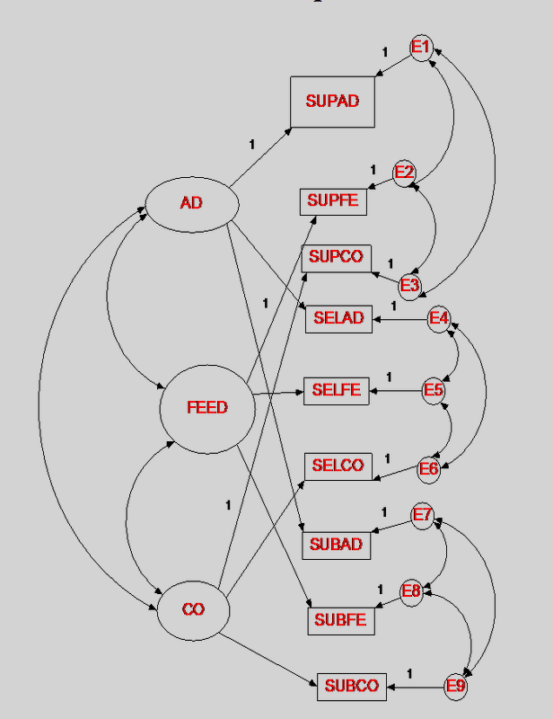

Slide 31
Correlated Uniqueness
You do not have anything to compare the model to though … you just use the parameter comparisons explained earlier.

Slide 32
Correlated Uniqueness
Convergent validity – check out the standardized estimates for each trait
Like factor loadings want them to be significant (usually above .300)

Slide 33
Correlated Uniqueness
Discriminant validity – you will check out the correlation table for the traits (same rules)
You will then check out the correlations of the error terms within each method to determine if they are highly correlated (same rules)

